Slide 1


JAVA SE
(core java)
Lecture-33

Slide 2
Today’s Agenda
• Swing Programming in Java
Introduction
JFrame class

Slide 3


Developing Swing Programming
The “JFrame” Class: Just like we have frame class in awt similarly we have the JFrame class in swing. asusual we use the JFrame class to create the main window of our application.
Inheritance Hierarchy of “JFrame”:
java.lang.Object
java.awt.Component
java.awt.Container
java.awt.Window
Java.awt.Frame
javax.swing.JFrame

Slide 4

The “JFrame” class
Constructors of “JFrame”:
Public JFrame()
public JFrame(String title)
Method of “JFrame” class:
All methods of “JFrame” +3 more methods
public void setIconImage(Image)
public void setDefaultCloseOperation(int)
public Container getContentPane()
Arguments which can be passed to setDefaultCloseOperation() method:
JFrame.EXIT_ON_CLOSE
JFrame.DO_NOTHING_ON_CLOSE
JFrame.DISPOSE_ON_CLOSE
JFrame.HIDE_ON_CLOSE

Slide 5
Centering A JFrame
To set a JFrame at the center of desktop we have to take following steps:
1. Obtain an object of Toolkit class by calling it's method getDefaultToolkit( ), whose prototype is :
public static Toolkit getDefaultToolkit( )
2. Obtain the size of desktop by calling Toolkit's method getScreenSize( ) whose prototype is :
public Dimension getScreenSize( )
This method returns an object of Dimension class conatining "width" and "height" members which represent destop's width and height in pixels.
3. Finally we can use some basic maths to set the JFrames' size and position by calling the method setBounds( ) so that it is centerd on the desktop
jf.setBounds(d.width/4,d.height/4,d.width/2,d.height/2);

Slide 6
Example
Develop a JFrame based application to create a JFrame of 400*400 size with your name displayed in the title bar and set the background color of JFrame to red.
Solution:-
import javax.swing.*;
import java.awt.*;
class UseJFrame
{
public static void main(String [] args)
{
jframe jf=new JFrame(“Sachin’s JFrame”);
jf.setSize(400,400);
jf.setVisible(true);
jf.setBackground(color.red);
jf.setDefaultCloseOperation(Jframe.EXIT_ON_CLOSE);
}
}

Slide 7
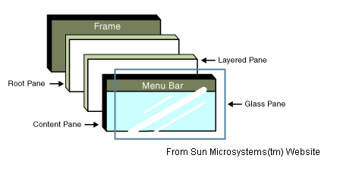
Although in the above ex. we did call setBackground() method but the color of the Frame did not change. This is because when we create a JFrame java actually piles up 5 windows on top of each other.
Starting from bottom these are:
Glass pane
Content Pane
Layered Pane
Root Pane
Frame

Slide 8
Now as we can observe from the above diagram the user sees Content Pane(because glass pane is invisible)and we had change the color of frame,so the color effect did not applied in the output.
Java provides us 2 solutions for this and the 2nd one is the industry recommended solution:
1. Obtain a reference to Content Pane and change its color:
Container ct=jf.getContentPane();
ct.setBackground(Color.red);

Slide 9
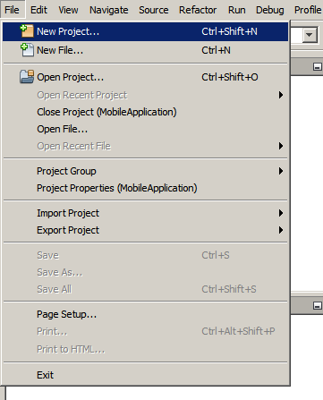
Create a JFrame
To create an IDE project:
1. Start NetBeans IDE.
2. In the IDE, choose File > New Project, as shown in the figure below.

Slide 10
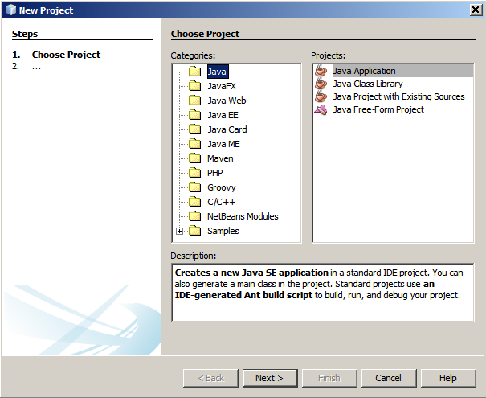
Create a JFrame
3. In the New Project wizard, expand the Java category and select Java Application as shown in the figure below. Then click Next.

Slide 11
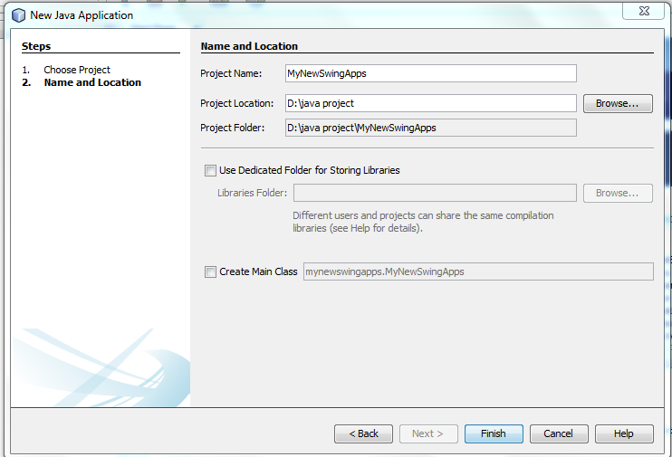
Create a JFrame
4. In the Name and Location page of the wizard, do the following (as shown in the figure below):
In the Project Name field, type MyNewSwingApps.
Save it in D drive by creating a folder name as java project,Project Location: D:\java project
Uncheck the Main Class field.
And then click on finish.

Slide 12
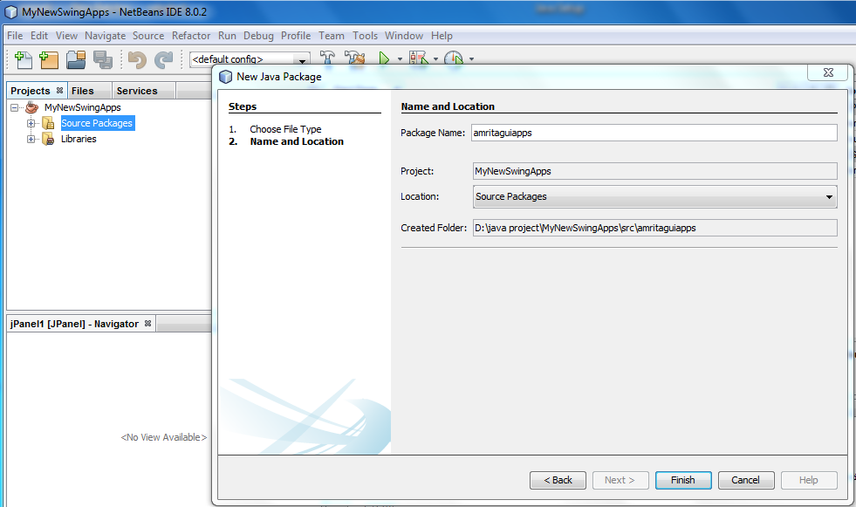
Create a JFrame
5. Now create a package by right clicking on source package,type Package name: amritaguiapps,then click on finish.

Slide 13
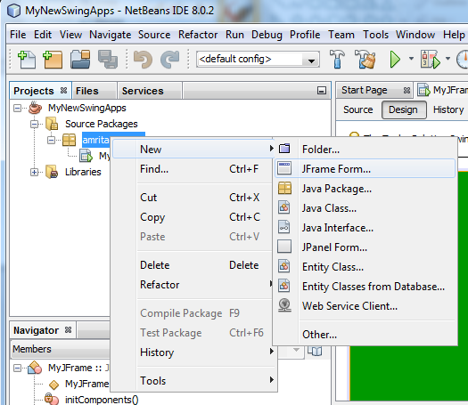
Create a JFrame
6. Now to create a JFrame right click on source package:amritaguiapps →New→JFrame Form.

Slide 14
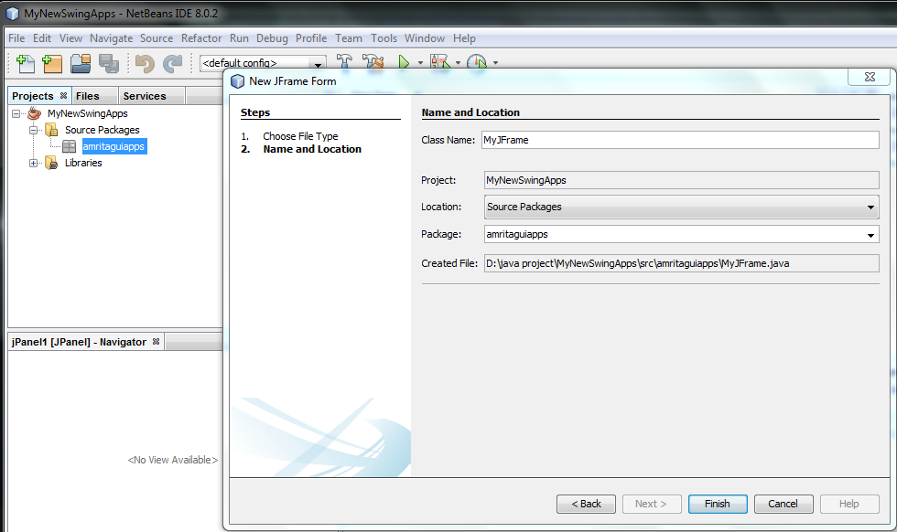
Create a JFrame
Class Name: MyJFrame then click Finish.

Slide 15
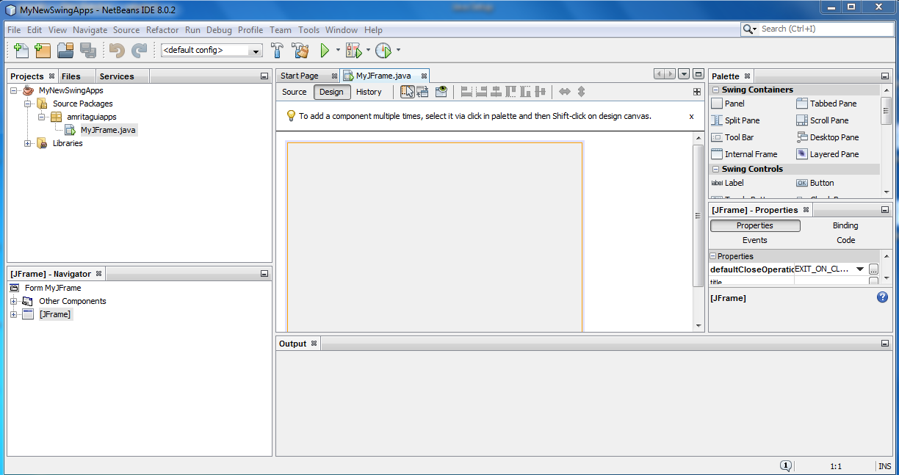
Create a JFrame
It will look like this:

Slide 16
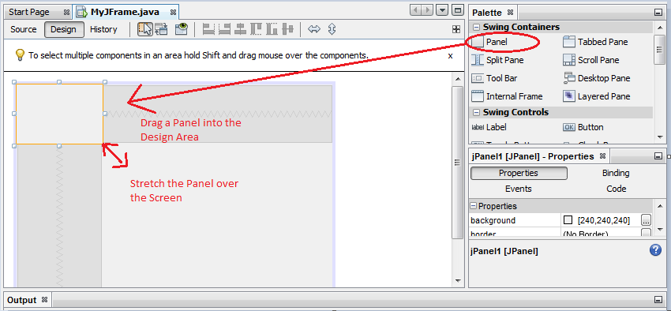
How to Add a Panel to Frames
Adding the Background color is just the matter of few drags and drops. Open the Jframe windows, drag the Panel from the Palette which is located in the upper right corner to the Design area.

Slide 17
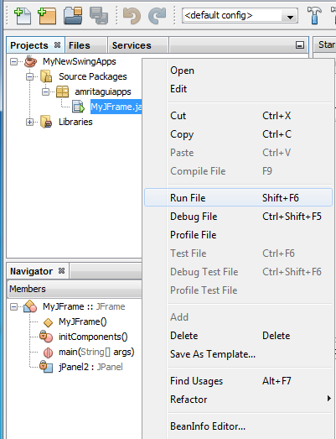

Run the Project
Run the project:
To run the project right click on
Jframe and click on Run File.
After click on Run File the output window look like this.

Slide 18
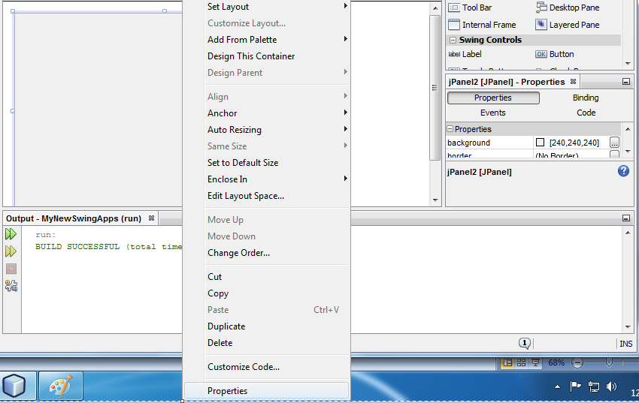
How to add Background Color to JFrame
To add background color of JFrame right click on JFrame,then click on properties as shown below:

Slide 19
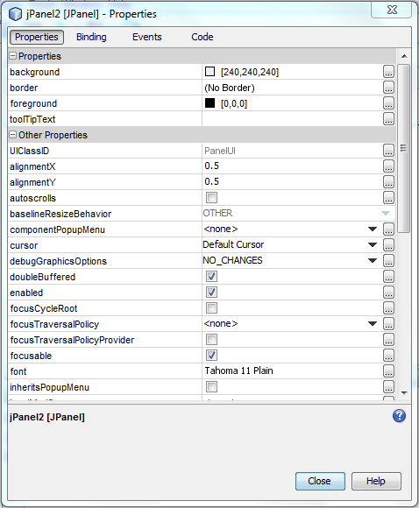
How to add Background
Color to JFrame
Now click on Properties→background →Close ,as shown below:
Click Here

Slide 20
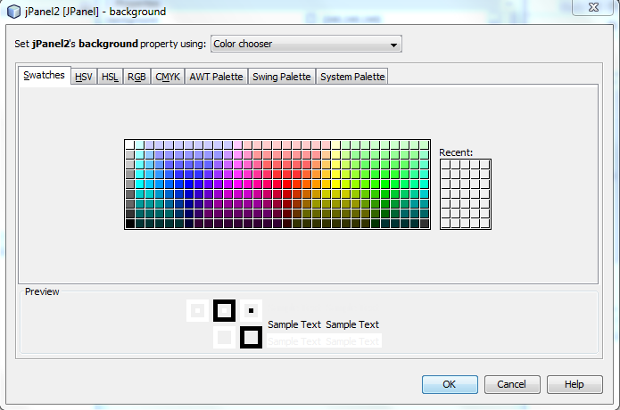
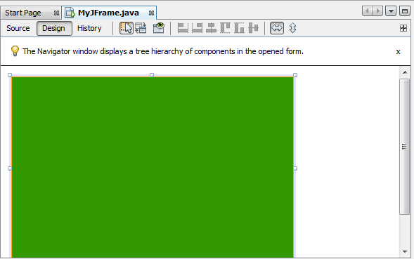
How to add Background
Color to JFrame
Choose a color and then click on OK.
Finally it look like this:

Slide 21
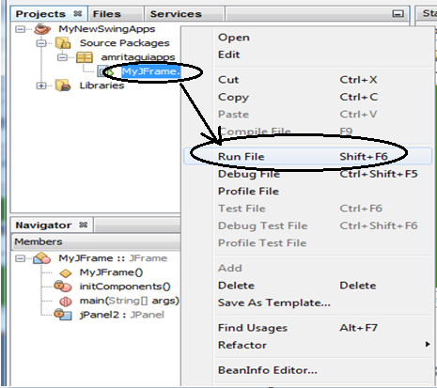
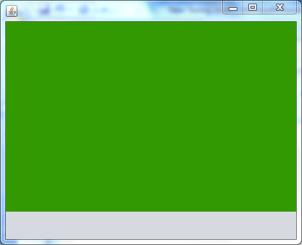
How to add Background
Color to JFrame
To Run the Project right click on MyJFrame.java then click on Run File, the output look like this :
Output Window

Slide 22

End Of Lecture 33
For any queries mail us @: scalive4u@gmail.com
Call us @ : 0755-4271659, 7879165533
Agenda for Next Lecture:
1. Changing icons in JFrame.
2. Handling Events in Netbeans.

